Slide 1
FLORIADE PROJECT GROUP 2
Ana Maria Nitu, Bianca Onea, Stela Trencheva,
Matei Mitran, Vid Barbaro

Slide 2
TABLE OF CONTENTS
01
WHAT WE DID?
02
03
04
NEW IDEAS
WHAT’S NEXT?
Q/A - DISCUSSION

Slide 3




WHAT WE DID?
Exploring framework options

Slide 4
RAPID PROTOTYPING

Slide 5
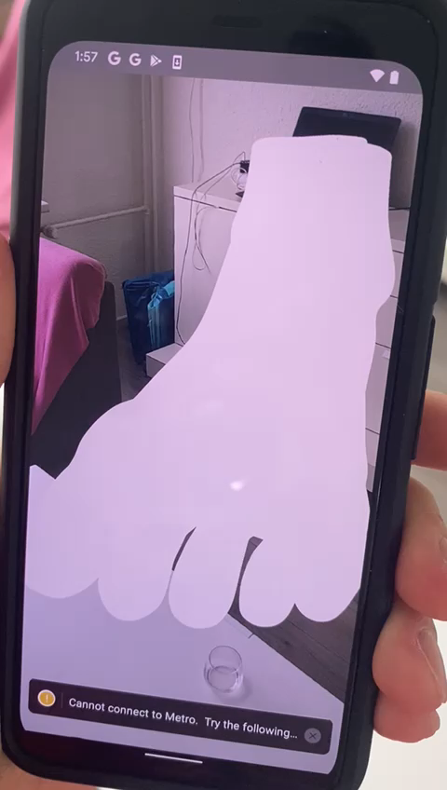
REACT NATIVE
USING GEOLOCATION

Slide 6
UNITY ARFoundation
USING TAP TO PLACE

Slide 7
IOS ARKIT
USING TAP TO PLACE

Slide 8
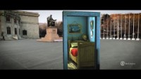
NEW IDEAS

Slide 9
PORTAL DOOR IDEA
PROS
CONS
Size shock factor still there
No occlusion
Available everywhere
The foot wouldn’t be just on the exposition

Slide 10
WHAT’S NEXT?
CHOOSING A FRAMEWORK
MERGE OR SPLIT WITH GROUP 1?
RAPID LOW- FI PROTOTYPING
START OF DEVELOPMENT

Slide 11
Q/A - DISCUSSION

